Slide 1

Barley Crop Report 2018

Slide 2
2017 Recap
Bumper yields in Australia stabilized markets going into Northern Hemisphere growing season
Difficult conditions in Europe
  Dry during growing season
  Wet at harvest
Dry conditions in North America
  Good soil moisture at start of season
  Dried out throughout the season
Good to average barley quality
Benign Energy Markets

Slide 3
2018 Highlights
Dry growing conditions across Europe
Malting barley prices have risen globally driven by short crops in Europe
Logistics costs are rising due to tightening shipping supply and driver availability in U.S.

Slide 4
2018 Europe Barley Headlines
Dry hot growing conditions in Europe
Average to good conditions for winter crop
Spring Crop in relative short supply although imports to Europe unlikely
Baltics and Balkan countries very poor
Good crop is available in UK, France and Denmark
Prices for quality barley have risen

Slide 5
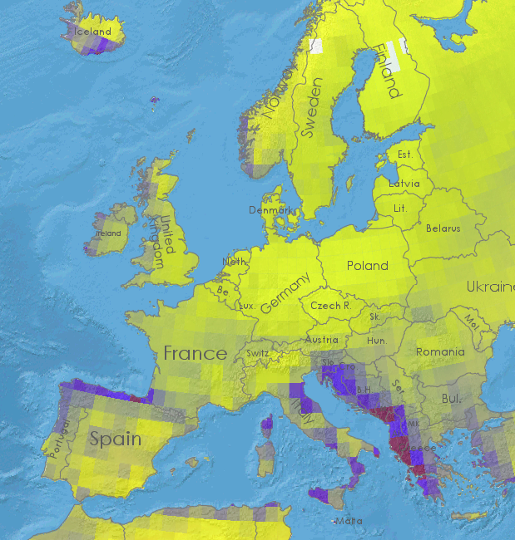
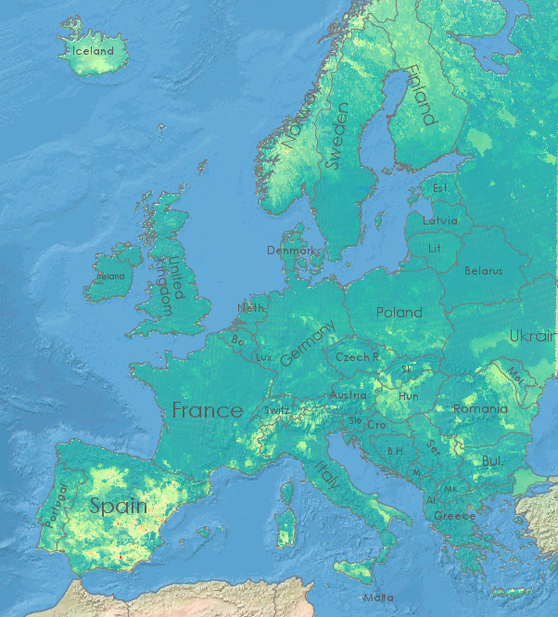
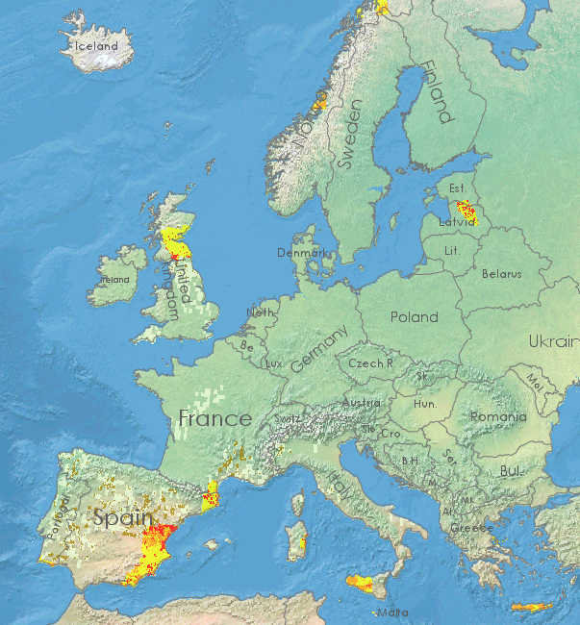



2018 European Growing Conditions
February
Rainfall
Soil Moisture
Soil Moisture Anomaly
Drier
Wetter
Drier
Wetter
Drier
Wetter

Slide 6
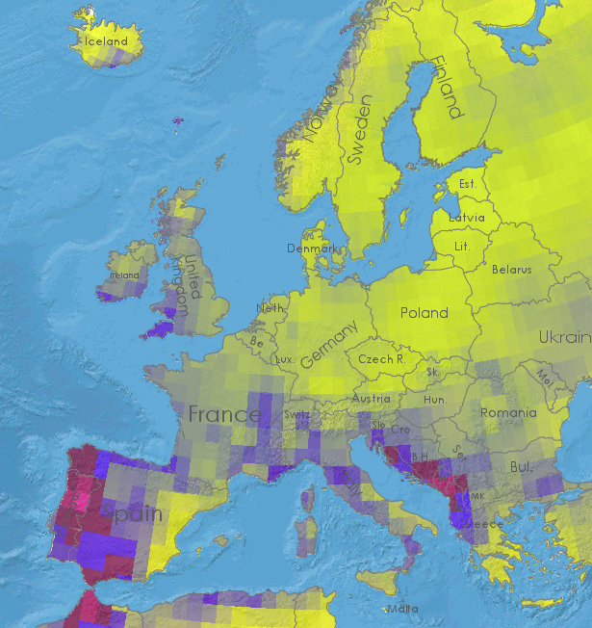
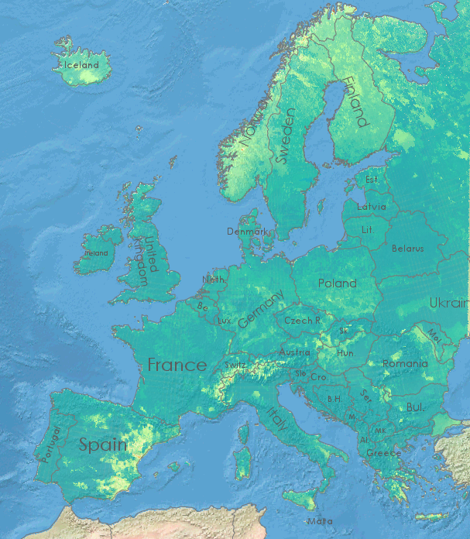
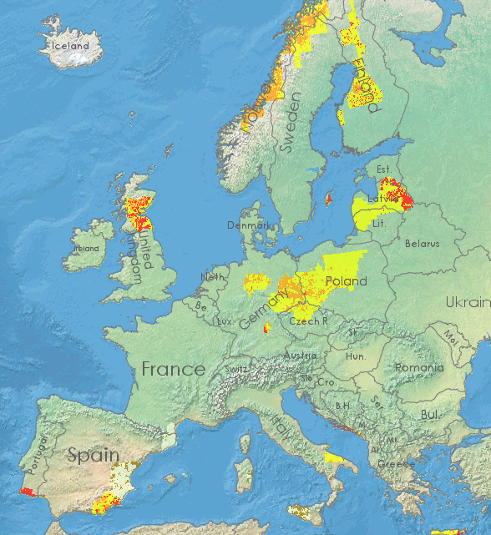
2018 European Growing Conditions
March
Rainfall
Soil Moisture
Soil Moisture Anomaly
Drier
Wetter
Drier
Wetter
Drier
Wetter

Slide 7
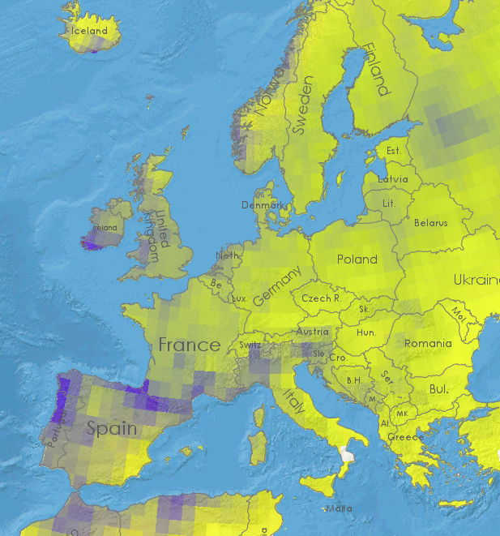
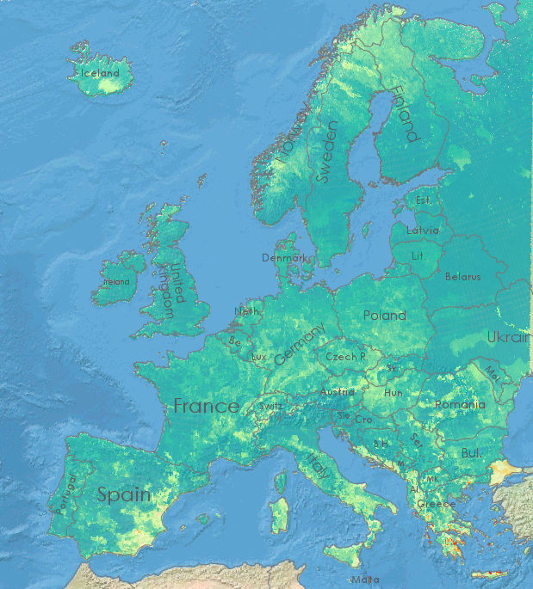
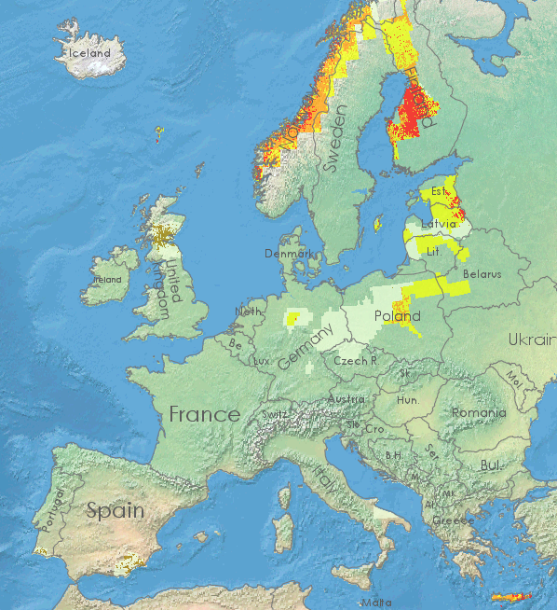
2018 European Growing Conditions
April
Rainfall
Soil Moisture
Soil Moisture Anomaly
Drier
Wetter
Drier
Wetter
Drier
Wetter

Slide 8
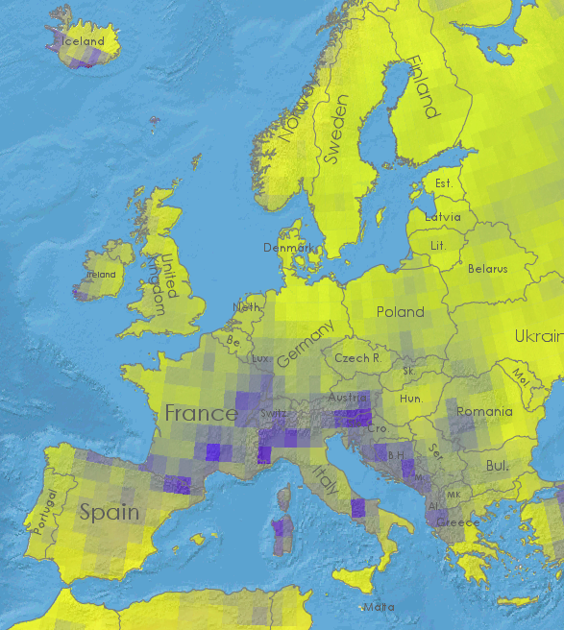
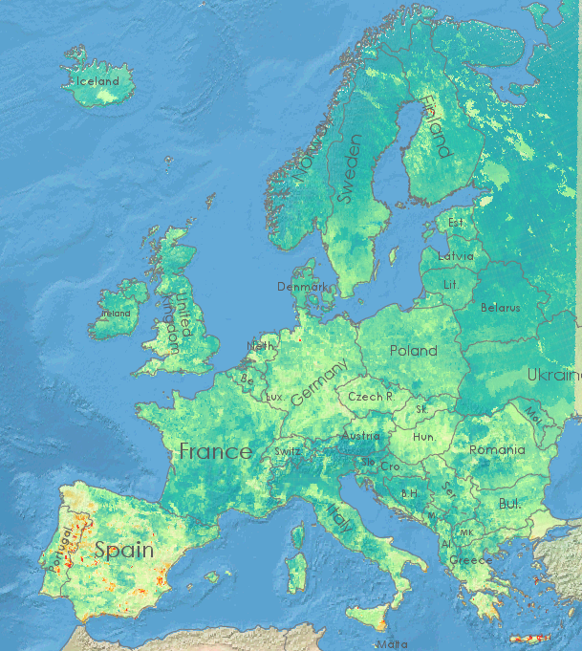
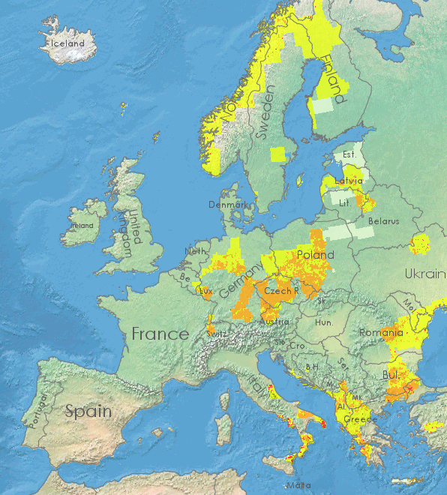
2018 European Growing Conditions
May
Rainfall
Soil Moisture
Soil Moisture Anomaly
Drier
Wetter
Drier
Wetter
Drier
Wetter

Slide 9
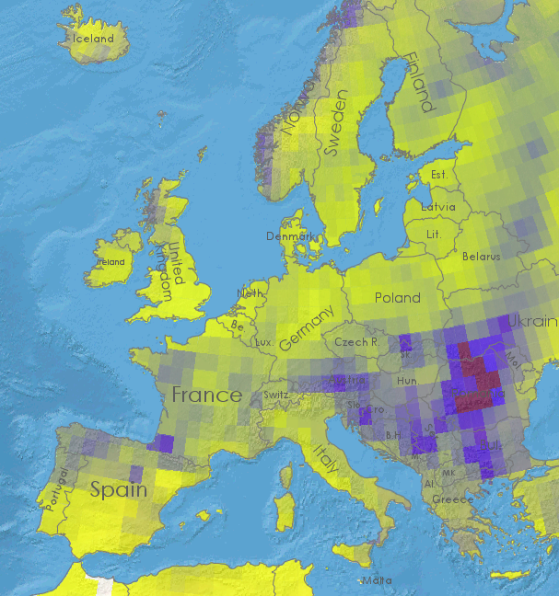
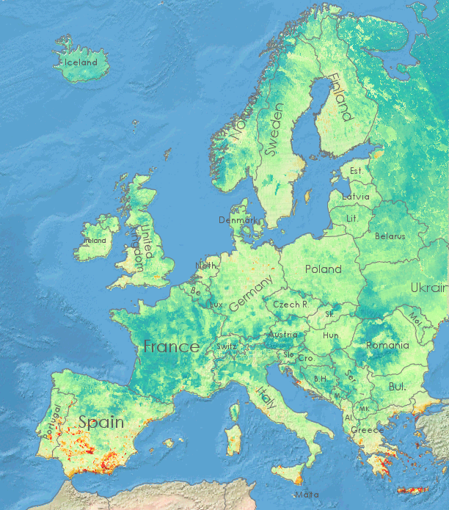
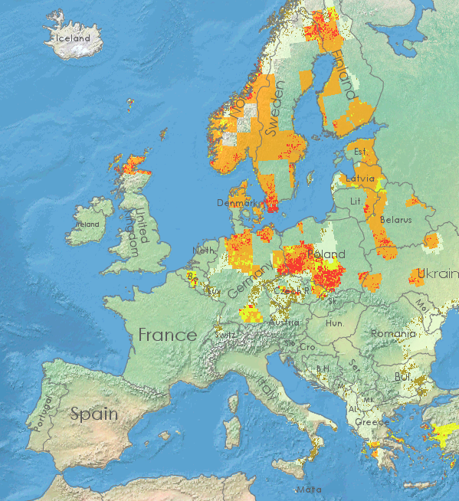
2018 European Growing Conditions
June
Rainfall
Soil Moisture
Soil Moisture Anomaly
Drier
Wetter
Drier
Wetter
Drier
Wetter

Slide 10
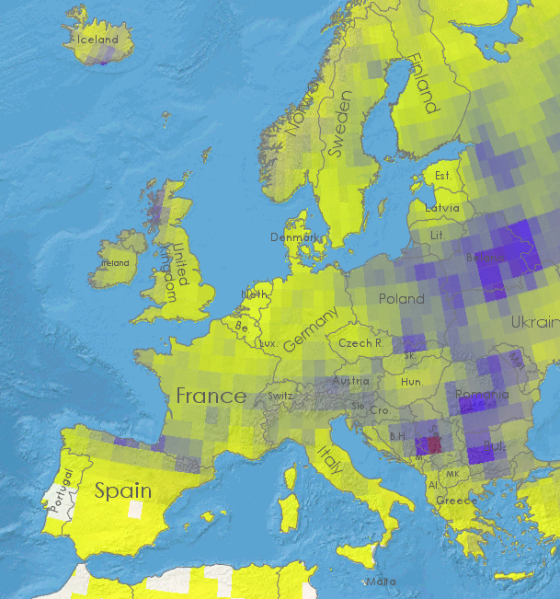
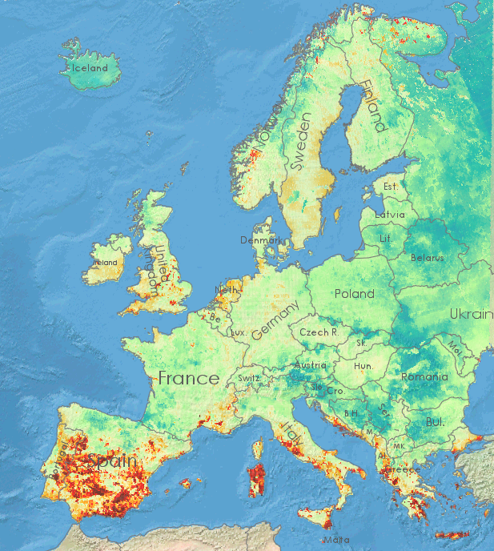
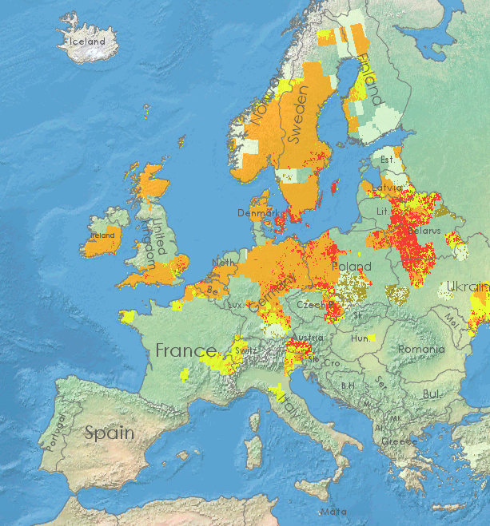
2018 European Growing Conditions
July
Rainfall
Soil Moisture
Soil Moisture Anomaly
Drier
Wetter
Drier
Wetter
Drier
Wetter

Slide 11
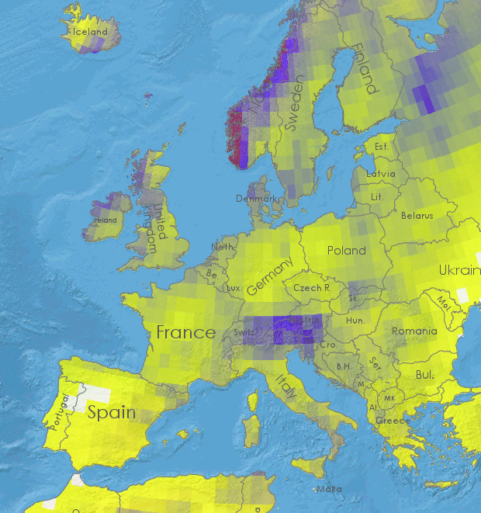
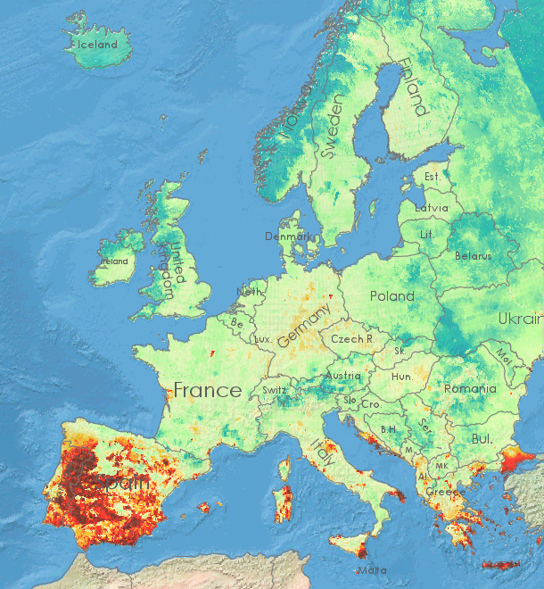
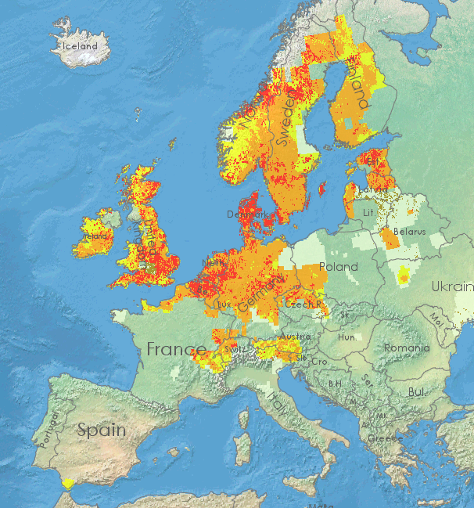
2018 European Growing Conditions
August
Rainfall
Soil Moisture
Soil Moisture Anomaly
Drier
Wetter
Drier
Wetter
Drier
Wetter

Slide 12
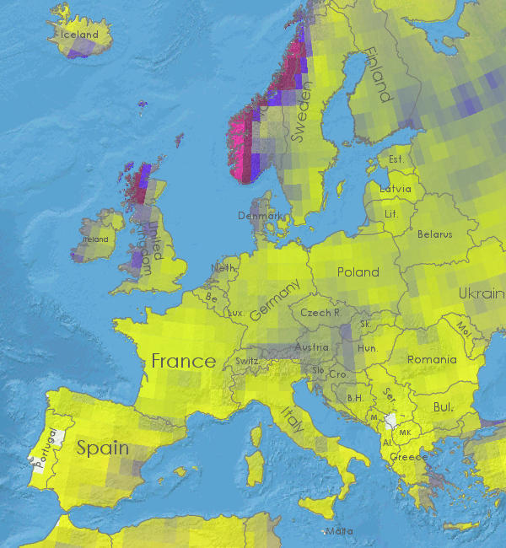
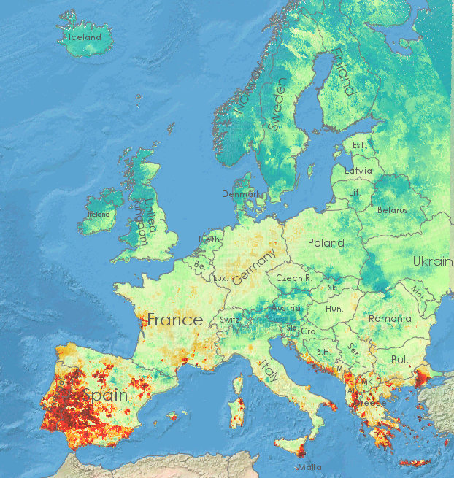
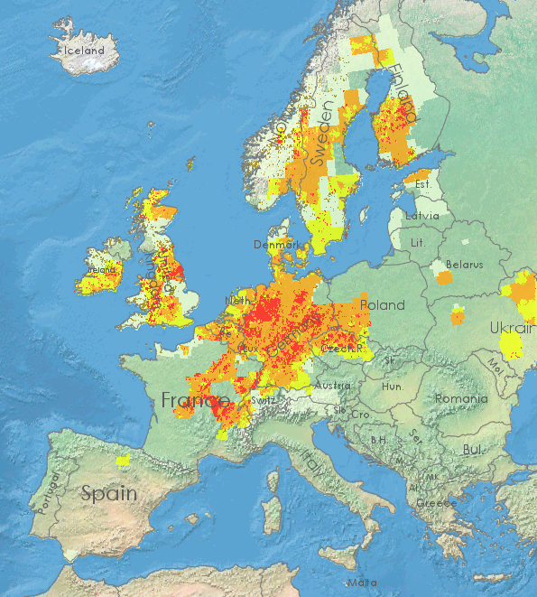
2018 European Growing Conditions
September
Rainfall
Soil Moisture
Soil Moisture Anomaly
Drier
Wetter
Drier
Wetter
Drier
Wetter

Slide 13
European Harvest 2018
 | Winter |  |  | Spring |  |  | Total
 | Acreage | Yield | Production | Acreage | Yield | Production | Acreage | Yield | Production
France | 1,302 | 6.34 | 8,255 | 485 | 6.27 | 3,042 | 1,787 | 6.32 | 11,297
Germany | 1,219 | 6.08 | 7,406 | 448 | 4.95 | 2,219 | 1,667 | 5.77 | 9,625
UK | 394 | 6.88 | 2,711 | 764 | 5.23 | 3,985 | 1,187 | 5.97 | 6,696
Denmark | 83 | 4.72 | 392 | 713 | 4.33 | 3,087 | 796 | 4.37 | 3,479
Poland | 215 | 2.93 | 630 | 764 | 2.41 | 1,936 | 1,018 | 2.52 | 2,566
Cz Republic | 97 | 4.91 | 506 | 222 | 4.8 | 1,066 | 325 | 4.84 | 1,572
Total EU-28 | 5,193 | 5.48 | 27,507 | 7,361 | 3.93 | 28,932 | 12,378 | 4.56 | 56,429
Area x 1000 Ha, Production x 1000 MT Source Eurostat Danish Spring Production and yields are Estimates Dataset from Eurostat source and do not necessarily calculate out directly

Slide 14
European 3 Year Comparison
 | Acreage |  |  | Yield |  |  | Production
 | 2016 | 2017 | 2018 | 2016 | 2017 | 2018 | 2016 | 2017 | 2018
France | 1,918 | 1,909 | 1,787 | 5.44 | 6.26 | 6.32 | 10,435 | 11,944 | 11,297
Germany | 1,605 | 1,567 | 1,667 | 6.69 | 6.93 | 5.77 | 10,730 | 10,853 | 9,625
UK | 1,122 | 1,171 | 1,156 | 5.93 | 5.97 | 5.79 | 6,655 | 7,086 | 6,696
Denmark | 707 | 666 | 796 | 5.59 | 5.92 | 4.37 | 3,949 | 3,946 | 3,479
Poland | 915 | 994 | 954 | 3.76 | 3.90 | 2.52 | 3,442 | 3,723 | 2,566
Cz Rep. | 326 | 328 | 325 | 5.66 | 5.22 | 4.84 | 1,845 | 1,712 | 1,572
EU 28 | 12,335 | 12,053 | 12,378 | 4.87 | 4.56 | 4.56 | 60,064 | 58,648 | 56,429
Area x 1000 Ha, Production x 1000 MT Source Eurostat Dataset for prior years updated as of Nov 2017

Slide 15
Evolution of Barley Pricing 2013-17

Slide 16
Broader context of barley prices

Slide 17
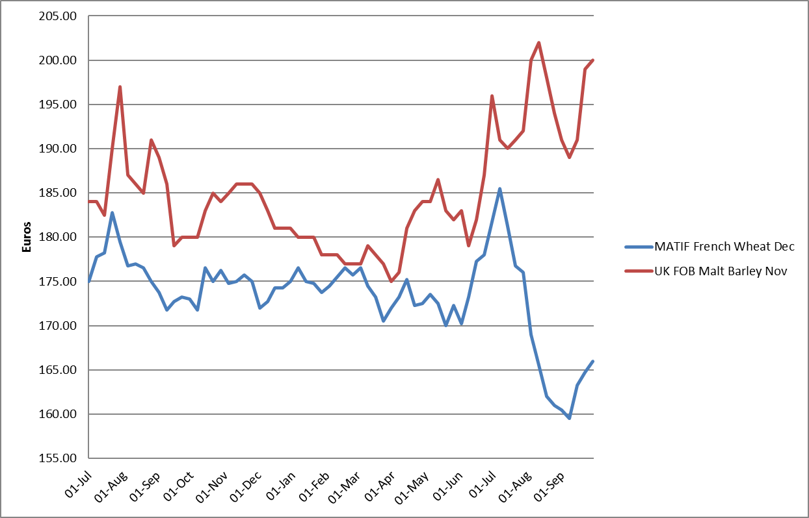
Malt premium spread widening

Slide 18
2018 European Quality
France produced a better crop than 2017 with some exportable volumes
  Protein 10.0- 11.3%, sizing 90%+
Germany some pre-sprout damage and will have to be selected carefully, concerns about germination in some regions
  protein 10.3%, sizing 93%
English spring crop is variable good sizing but generally variable protein
  proteins 8.75%- 11.25%(sizing 92%
Maris Otter has produced a quality plentiful crop
  9.2% protein, sizing 87%
Denmark short crop volume of average quality
  protein +11% , sizing > 90%
Scotland typically challenged by the weather produced crop which distillers will need to accept
  protein +11%, sizing 96%
Eastern European maltsters will have to accept some very high protein +14% to find sufficient barley

Slide 19
US Barley Headlines
Carry in stocks remain sufficient due to 2017
Planting marginally up in 2018
Harvested acreage and production up over 2017
Benign growing conditions giving rise to a favorable crop in all regions

Slide 20
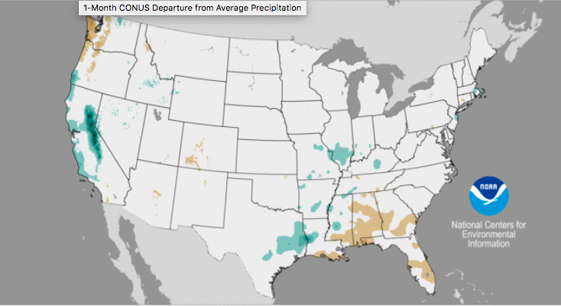
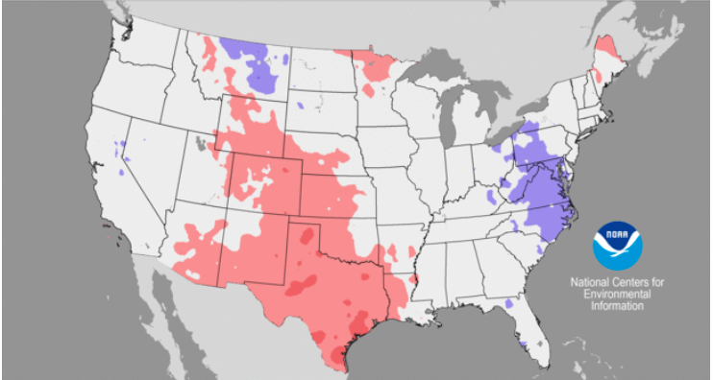
2017 US Growing Conditions
Precipitation Anomaly
March
Relatively normal conditions in all growing regions
Early warmth in MN and MT permitted good seeding progress
Temperature Anomaly

Slide 21
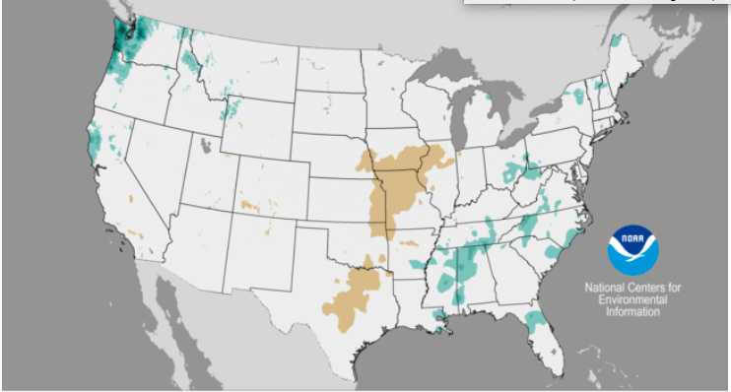
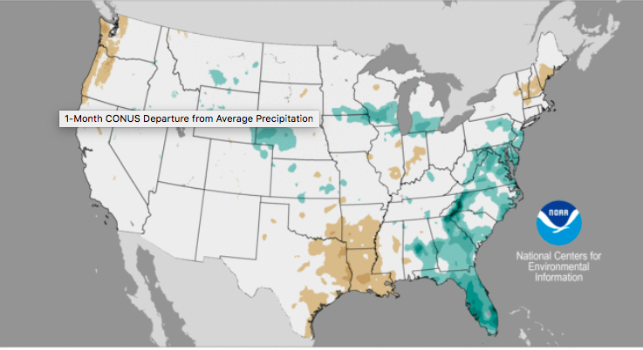
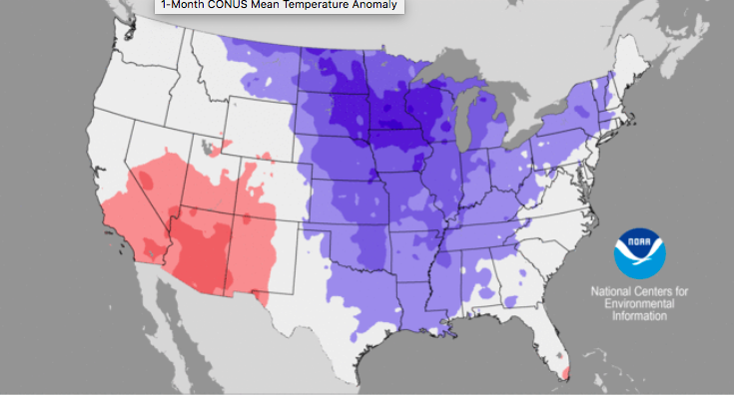
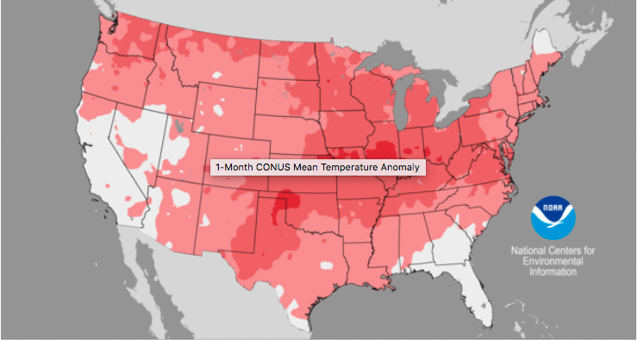
2017 US Growing Conditions
April
May
Precipitation Anomaly
Precipitation Anomaly
Temperature Anomaly
Temperature Anomaly

Slide 22
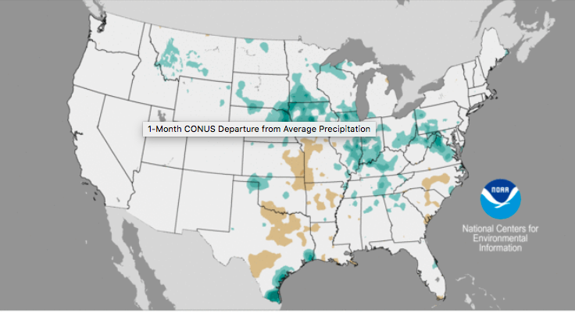
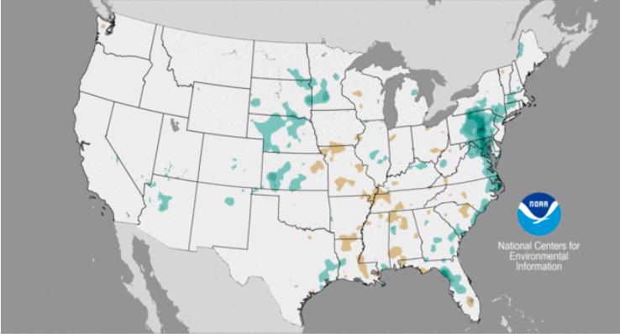
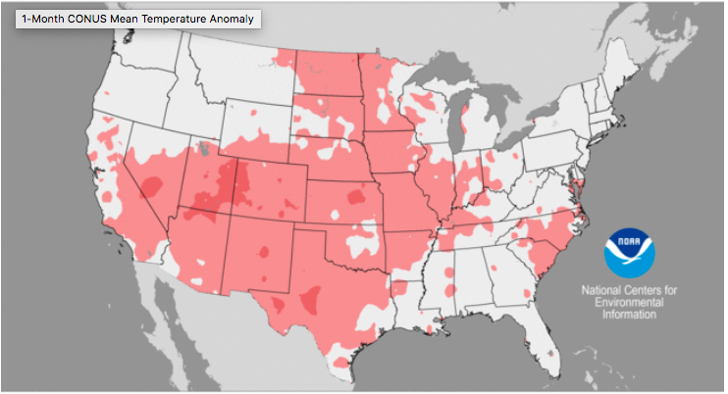
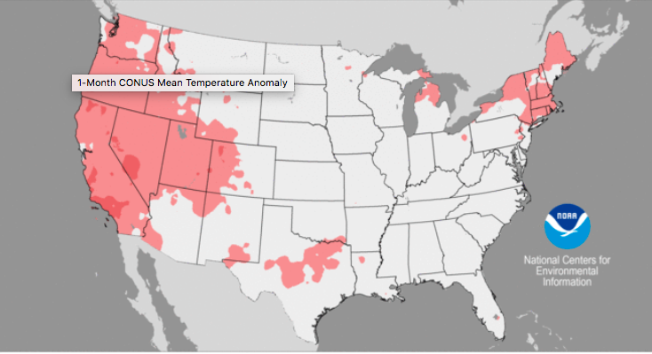
2017 US Growing Conditions
June
July
Precipitation Anomaly
Precipitation Anomaly
Temperature Anomaly
Temperature Anomaly

Slide 23
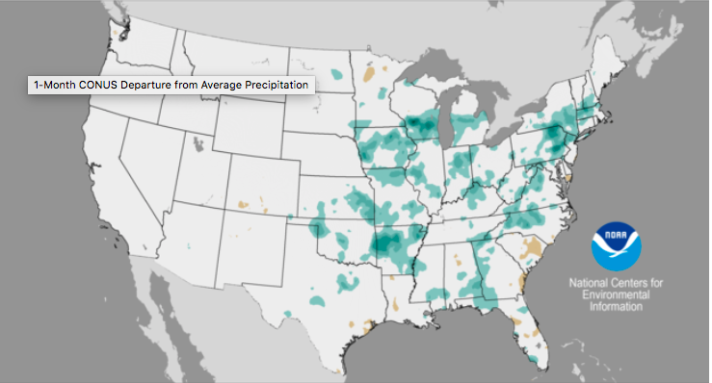
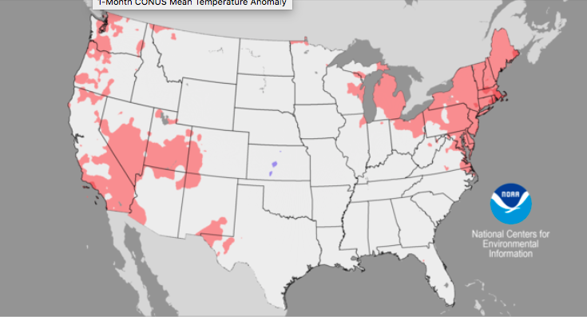
2017 US Growing Conditions
August
Warm dry conditions gave rise to rapid harvest progress.
Crops are reported to be good with no weather related damage
Precipitation Anomaly
Temperature Anomaly

Slide 24
US Barley Production
 | Seeded |  |  | Harvested |  |  | Production
 | 2016 | 2017 | 2018 | 2016 | 2017 | 2018 | 2016 | 2017 | 2018 | 2018
Minnesota | 95 | 80 | 80 | 66 | 76 | 67 | 5,214 | 5,168 | 5,092 | 111
N Dakota | 740 | 520 | 470 | 640 | 395 | 385 | 42,880 | 24,885 | 28,490 | 619
Montana | 990 | 770 | 790 | 780 | 565 | 600 | 46,800 | 28,815 | 33,600 | 730
Idaho | 600 | 530 | 550 | 580 | 510 | 530 | 62,060 | 48,450 | 53,530 | 1,163
Colorado | 80 | 70 | 58 | 75 | 68 | 52 | 9,675 | 8,976 | 7,540 | 164
Wyoming | 95 | 82 | 71 | 82 | 63 | 50 | 7,161 | 4,505 | 5,000 | 109
Washington | 110 | 95 | 85 | 93 | 85 | 67 | 7,161 | 4,505 | 4,891 | 106
California | 85 | 70 | 65 | 60 | 28 | 26 | 4,125 | 1,400 | 1,794 | 39
Oregon | 45 | 47 | 43 | 32 | 38 | 26 | 2,144 | 2,356 | 1,378 | 30
Other | 219 | 217 | 331 | 144 | 134 | 175 | 11,608 | 10,942 | 11,767 | 256
Total | 3,059 | 2,481 | 2,543 | 2,565 | 1,954 | 1,978 | 199,914 | 141,923 | 153,082 | 3,327
Area x 1000 acres Production x 1000 Bushels Source USDA As of Sept 29th 2017 |  |  |  |  |  |  |  |  |  | MT x 1000
Notes:
\

Slide 25
2018 US Crop Assessment
Smallest barley crop in the U.S. recorded on USDA searchable database
What was harvested in generally very good for malting
Sizing slightly lower than 2016 in some samples
Western 2 row proteins trending lower than 2016
Similar Total Protein in Midwest 2 row and 6 row than old crop
Very low evidence of DON
Barley bright with no staining

Slide 26
2017 Canadian Barley Headlines
Seeded Acreage down again in 2017
Good seeding conditions– Seeding completed early
Drying conditions throughout the growing season in the Southern Prairies
Good harvest conditions
Barley is generally of excellent quality

Slide 27
Canada Seeded Acreage
Seeded area to barley down slightly again last year and still historically low due to lower cattle feed requirement (-2.5 Million since 2005)
Malting varieties represent the overwhelming majority of the barley area

Slide 28
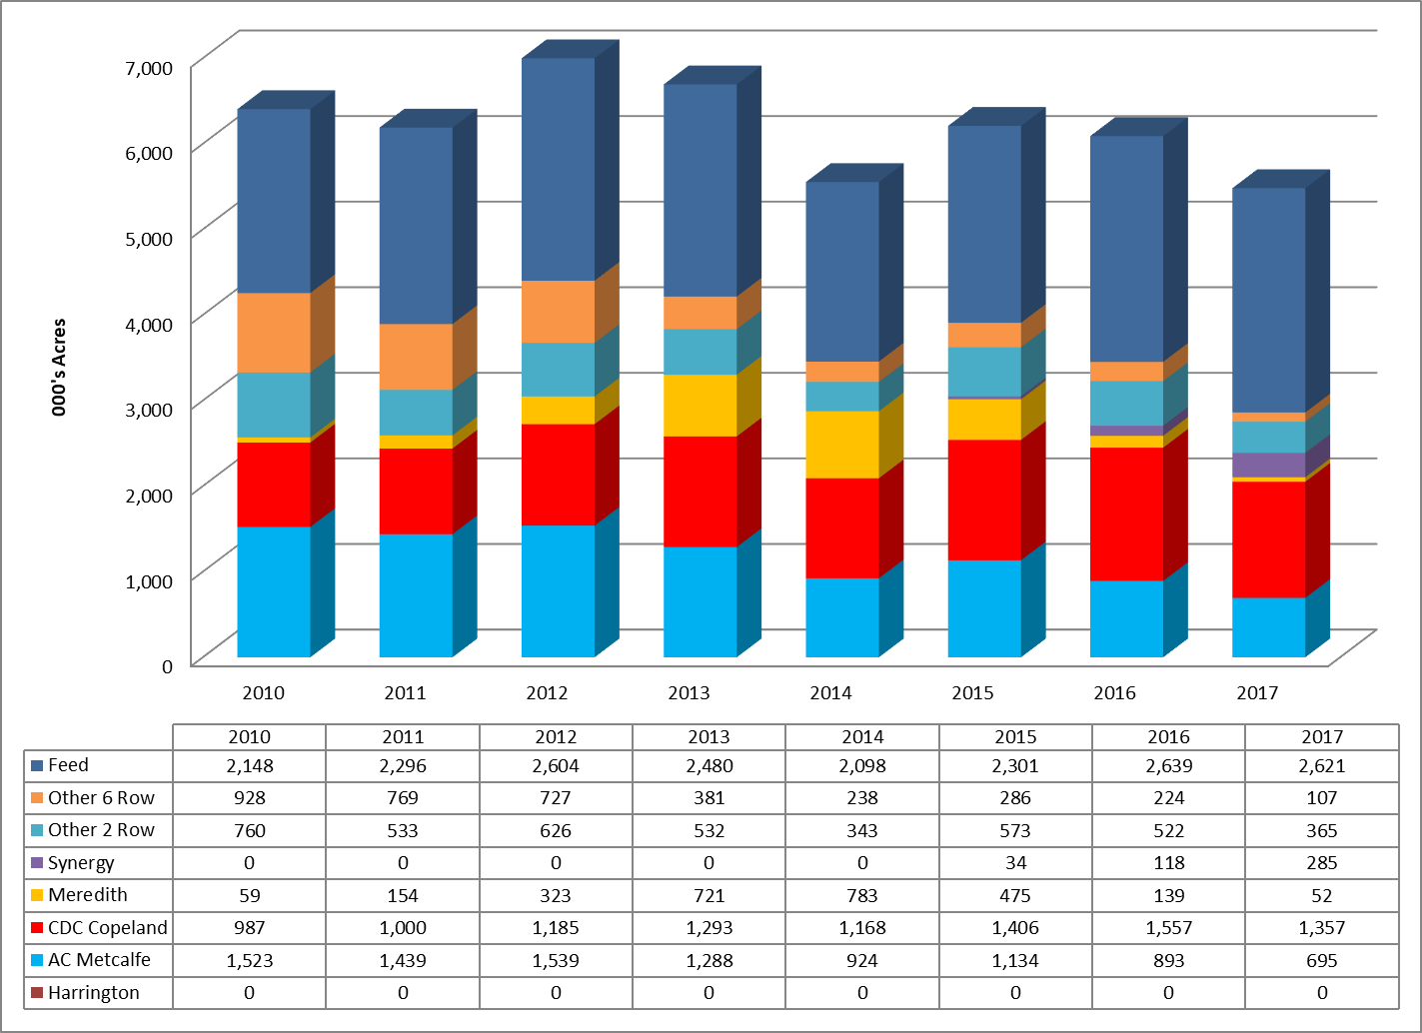
Western Canada Varieties Seeded

Slide 29
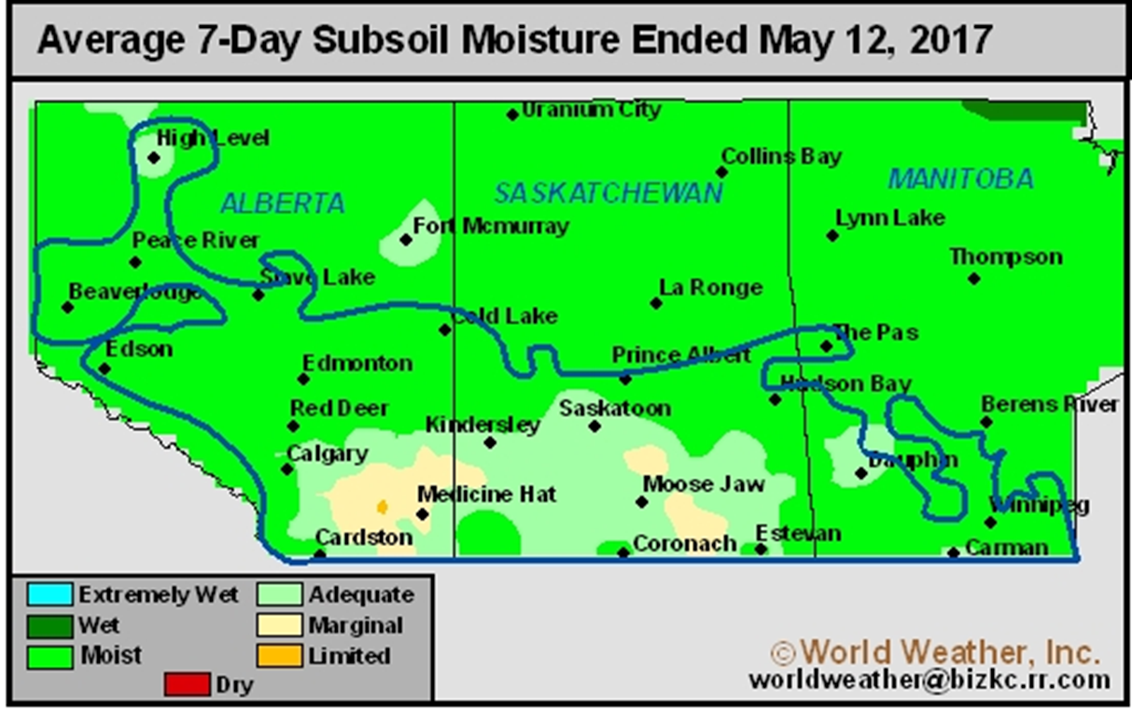
Canadian Prairie Sowing Conditions
Good seeding conditions Excessive field moisture in some areas cause delays
Overall completed ahead of Average
Moisture conditions ideal for even germination

Slide 30
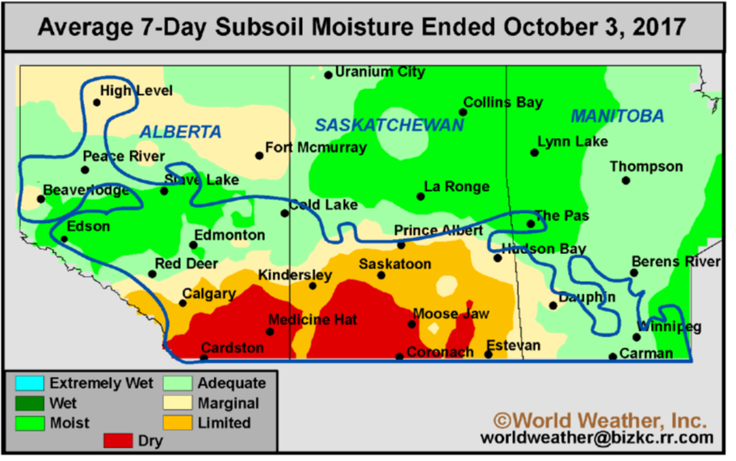
Canadian Crop Development
Dry growing conditions in the south of Alberta and Saskatchewan affected yields and to a lesser extent quality
Perfect harvest conditions
  Lower moisture
  No pre-sprout damage

Slide 31
Canadian Barley Production
Canadian barley areas and production 2015,2016 and 2017
 | Seeded |  |  | Harvested |  |  | Production
 | 2015 | 2016 | 2017 | 2015 | 2016 | 2017 | 2015 | 2016 | 2017
Alberta | 1,356 | 1,295 | 1,153 | 1,161 | 1,052 | 1,017 | 4,289 | 4,398 | 3,794
Manitoba | 162 | 146 | 107 | 148 | 138 | 105 | 566 | 540 | 407
Saskatchewan | 971 | 1,001 | 941 | 898 | 898 | 870 | 2,863 | 3,374 | 2,673
Total Canada | 2,641 | 2,586 | 2,335 | 2,354 | 2,223 | 2,120 | 8,226 | 8,784 | 7,305
Area x 1000 Ha Production x 1000MT Source Statcan
Yields down across the prairies, in Manitoba similar to 2016
Total harvest expectation down to 7.3 Million MT

Slide 32
2017 Canadian Crop Assessment
No pre-sprout damage!
Protein down a touch from 2016 crop. Ave <11%
Surprisingly, plump levels similar to 2016
Lower FAN and Soluble Protein
Lower Wort Color due to lower TP & FAN
Excellent modification
Lower enzymatic activity
Higher Extract

Slide 33
Global Barley Production 2018
World Barley Production X 1000 MT | 2016/2017 | 2017/2018 | 2018/2019 Prj. Nov
USA | 4,353 | 3,090 | 3,333
Australia | 13,506 | 8,900 | 7,800
Canada | 8,839 | 7,900 | 8,800
EU | 59,978 | 59,064 | 57,250
Russia | 17,547 | 20,183 | 16,500
Ukraine | 9,874 | 8,695 | 7,600
WORLD TOTAL | 147,167 | 144,271 | 141,254
Source USDA FAS

Slide 34
Production in Malting Barley Regions

Slide 35
Malt Barley Regions Carry Out

Slide 36
Global Ending Stocks 2018/19

Slide 37
Political Events
Brexit
  Driving uncertainty in currency markets especially GBP
Trump Tariffs causing concern in the soy markets and creating nervousness in grains

Slide 38
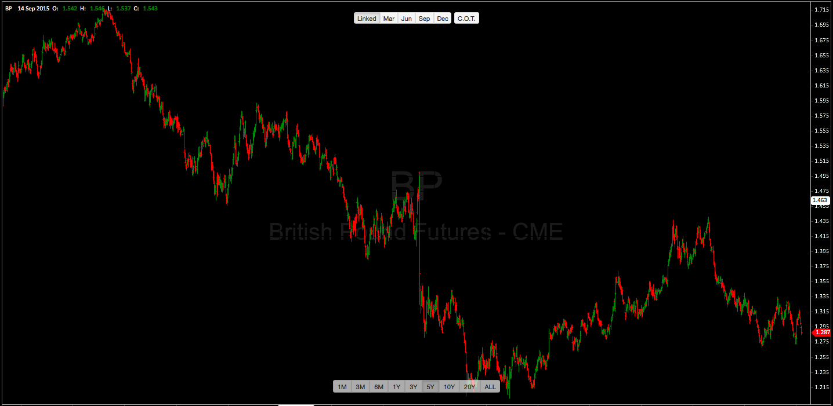
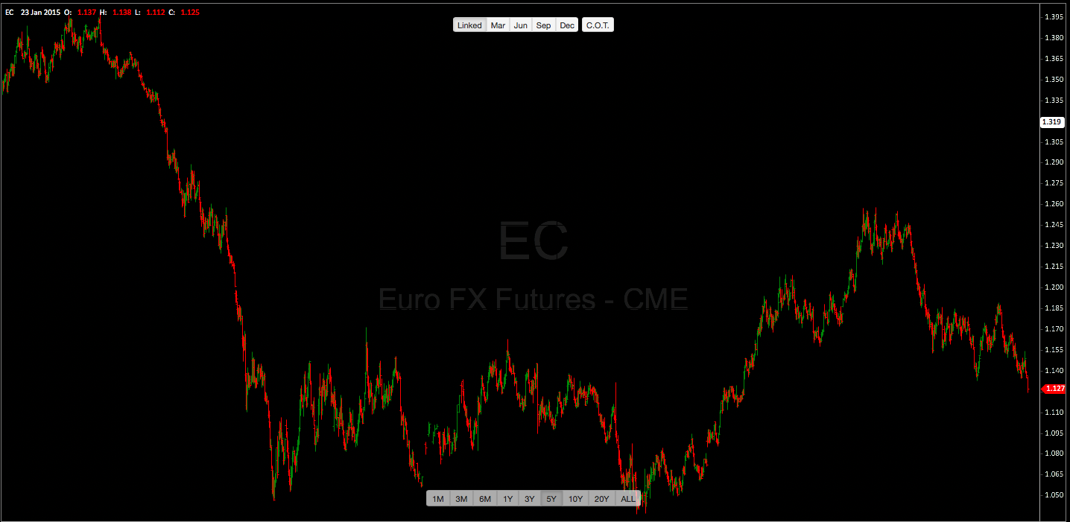
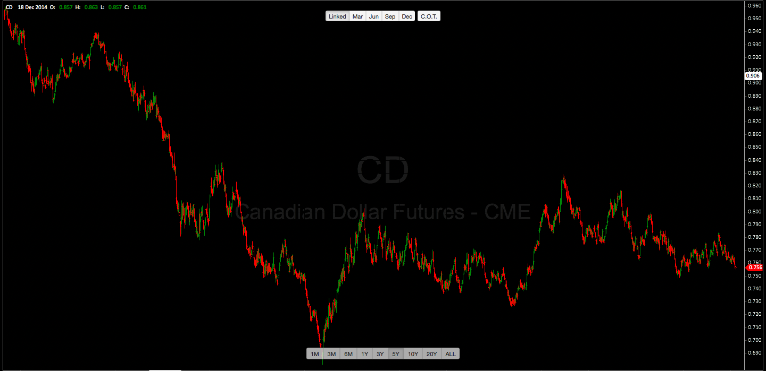
Currencies: 5 year chart
£1 = $1.287
GBP
€1 = $1.127
EUR
C$1 = $0.756
CAD

Slide 39
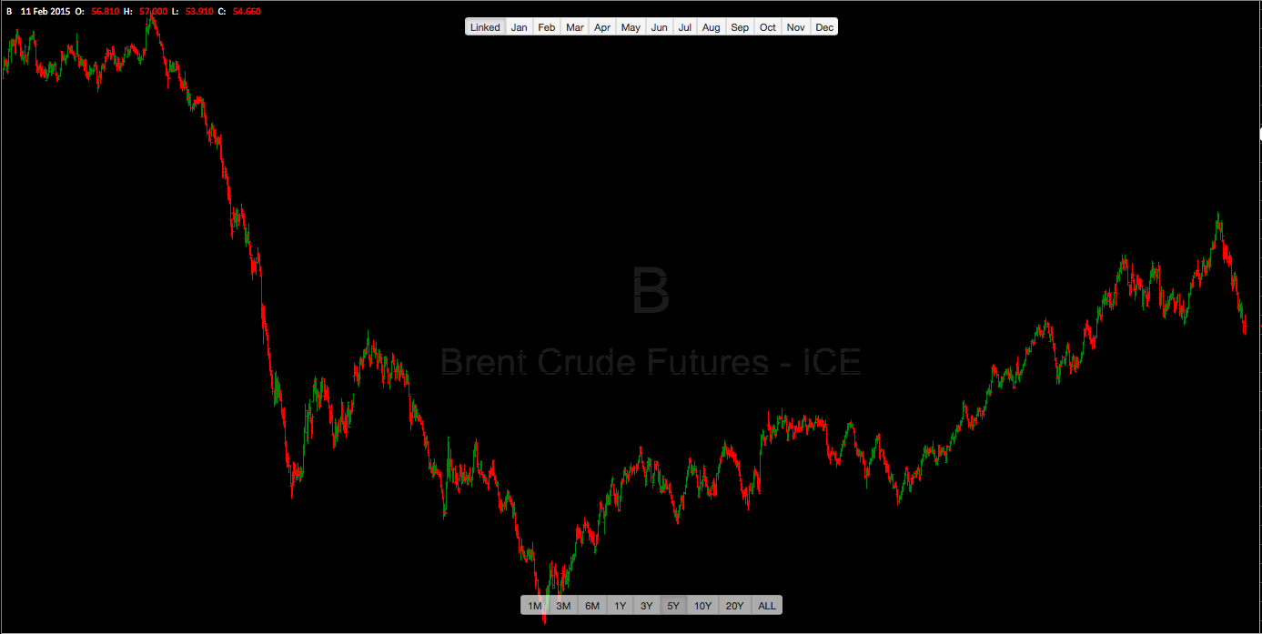
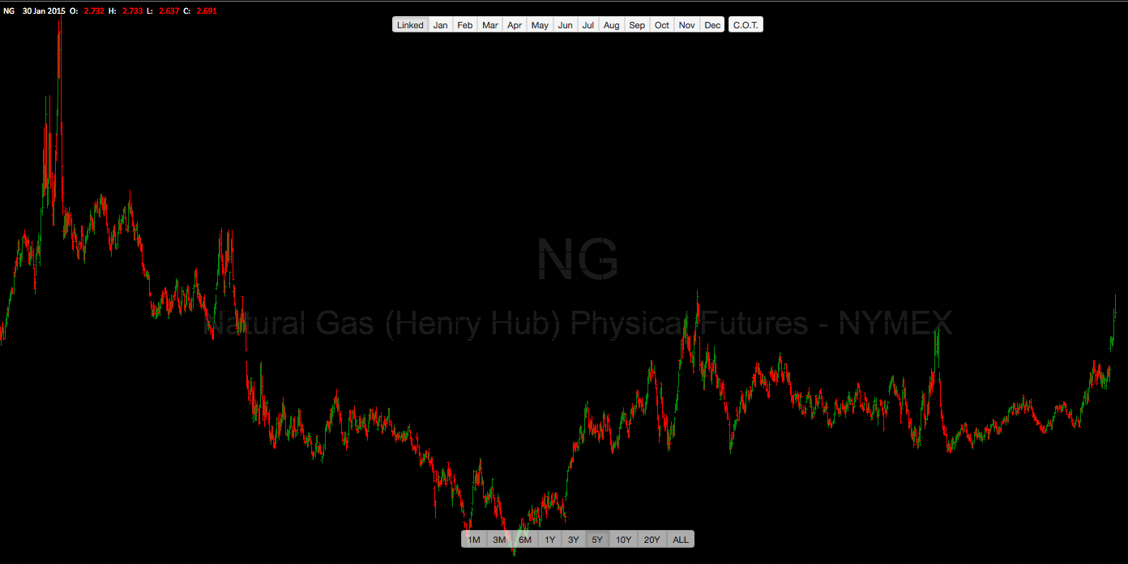
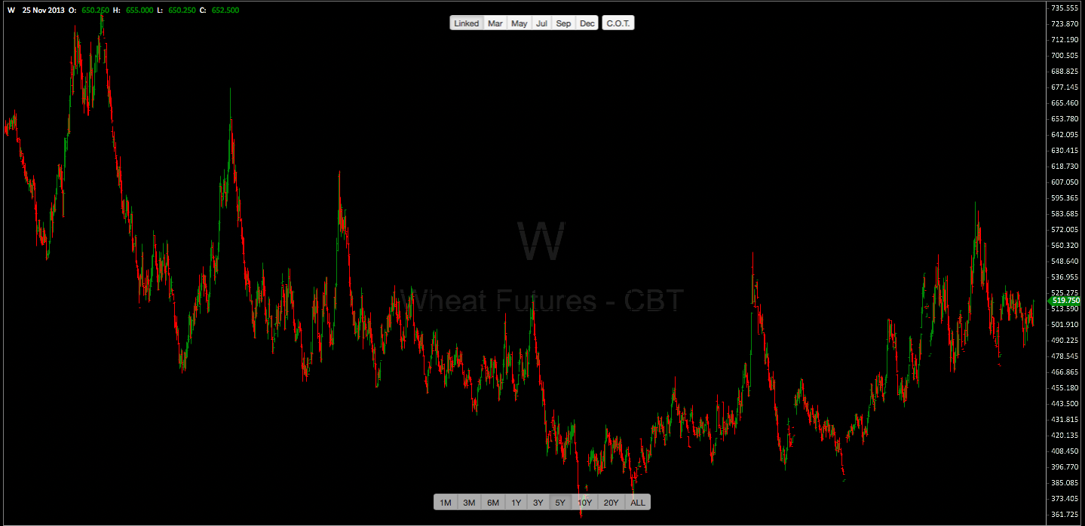
Commodities
$70.12
Brent Crude
$3.78
Natural Gas
$519.75
Wheat

Slide 40
Conclusions & Considerations 2018
French crop better than 2017 with some exportable
UK & German crop in tight supply
US a good year in quantity and quality
Canadian crop good quality
Oil markets up $10 contributing to rising transportation costs
Barley prices up over 2017
Overall malt quality in 2018 expected to be average to good
Global supplies of malting barley are very tight indeed
Another year of tight crops will see prices rise sharply in 2019
Logistics around the world becoming challenging due to availability of drivers in North America and shipping companies tightening supply
Notes:
40

Slide 41
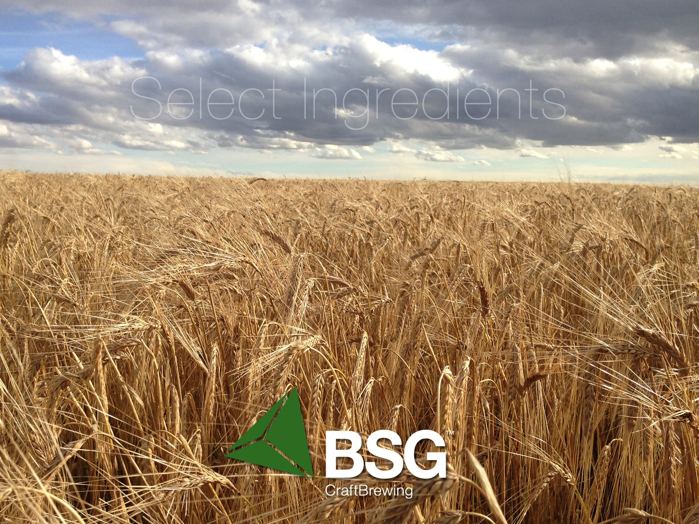
With thanks to:
Bob Sutton, Rahr Malting
Steve LePoidevin, Crisp Malting Group
Thomas Weyermann, Weyermann® Malz

